Slide 1

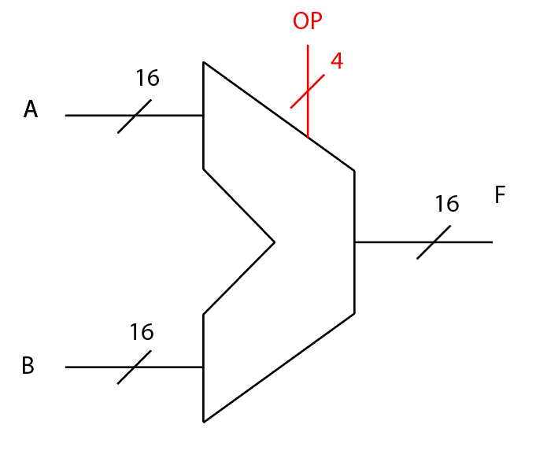
Simplified 16-Bit ALU
By Levi Randall and James Samawi

Slide 2

Uses of ALUs in Computers
Essential for almost all Arithmetic and Logical Processes
Also used for Indexing with Loading and Storing Processes
Simplifies overall hardware structure by having hardware change
effect with Control Signals
Supports pipeline structure

Slide 3
Project Specifics
16-Bit Processor
Supports: Multiplication, Left/Right Shifting, Addition, Subtraction, AND/NAND, OR/NOR
Designed and Implemented on the Logic Gate Level
Implemented with a Control Unit
Created and Implemented in Xilinx: Vivado

Slide 4
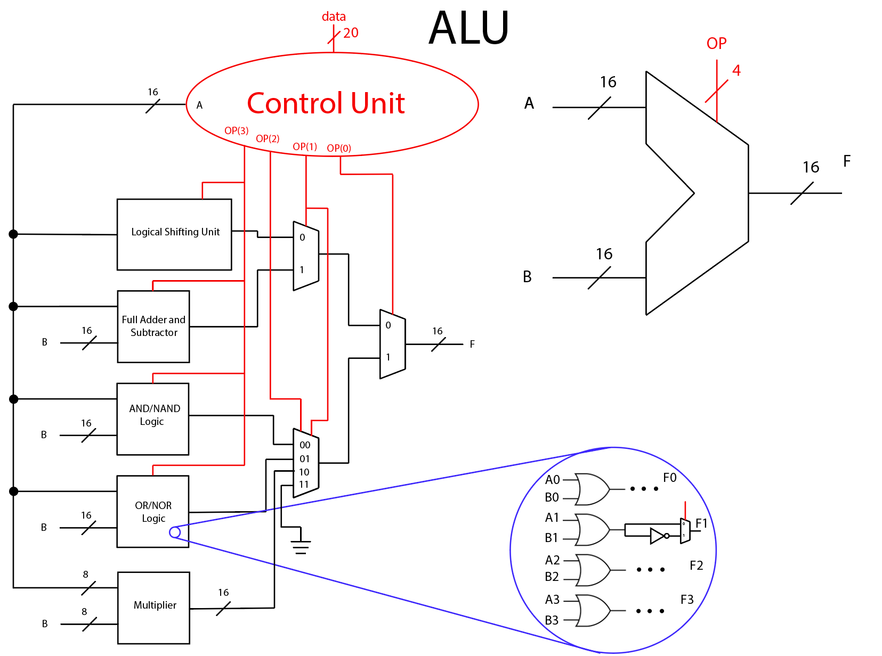
Overall Schematic

Slide 5
Worst Case Circuit Time Delays
2to1 8-Bit Multiplexer = 6ns
4to1 8-Bit Multiplexer = 10ns
AND/NAND Gate = 10ns
OR/NOR Gate = 10ns
RCA = 78ns
8x8 Multiplier = 48ns
Shifter = 6ns
Overall ALU = 90ns

Slide 6
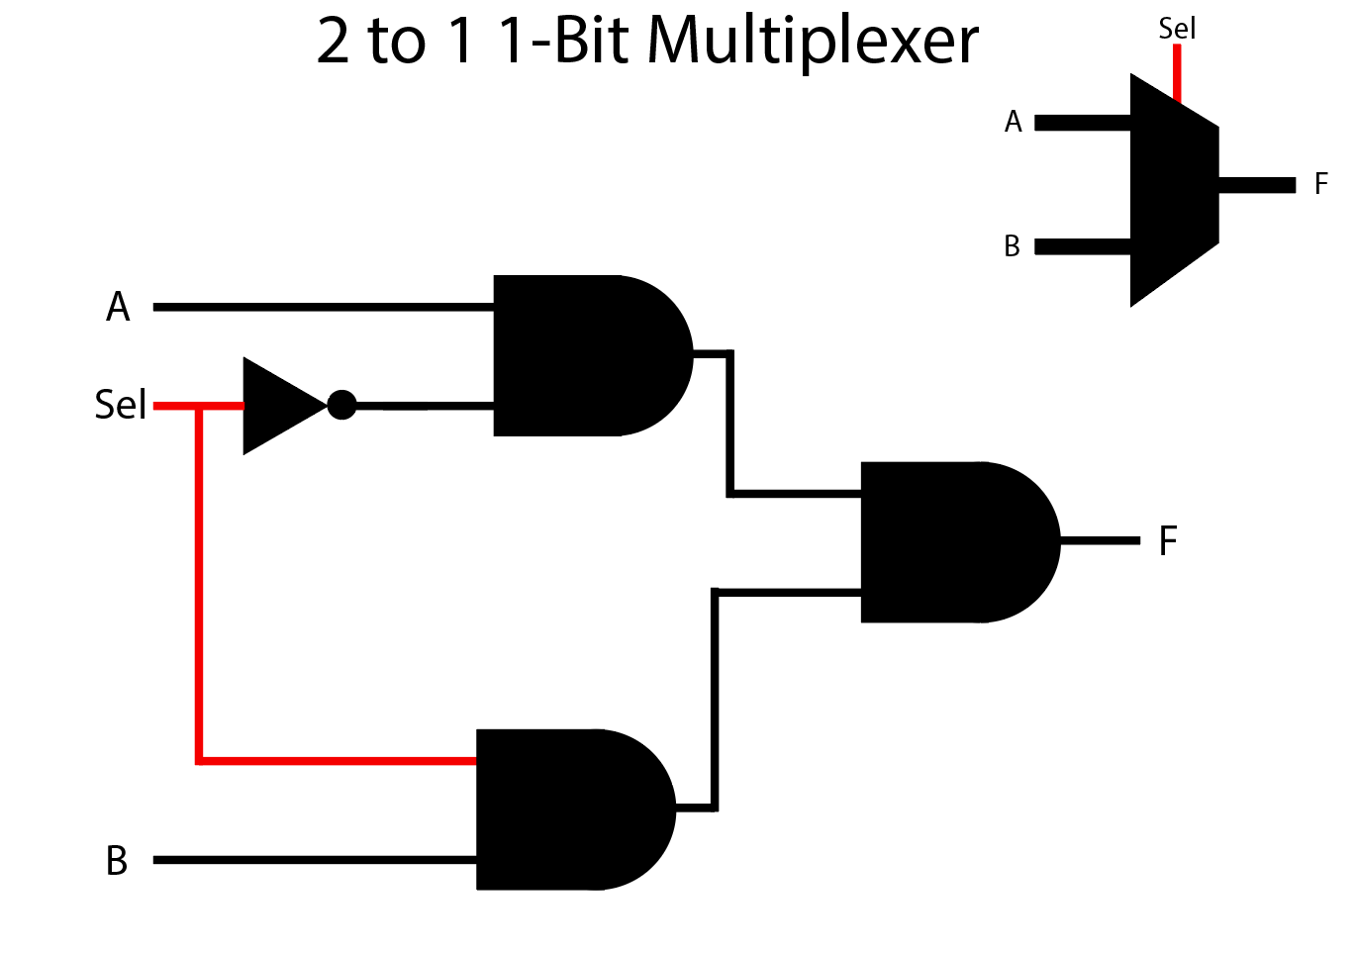
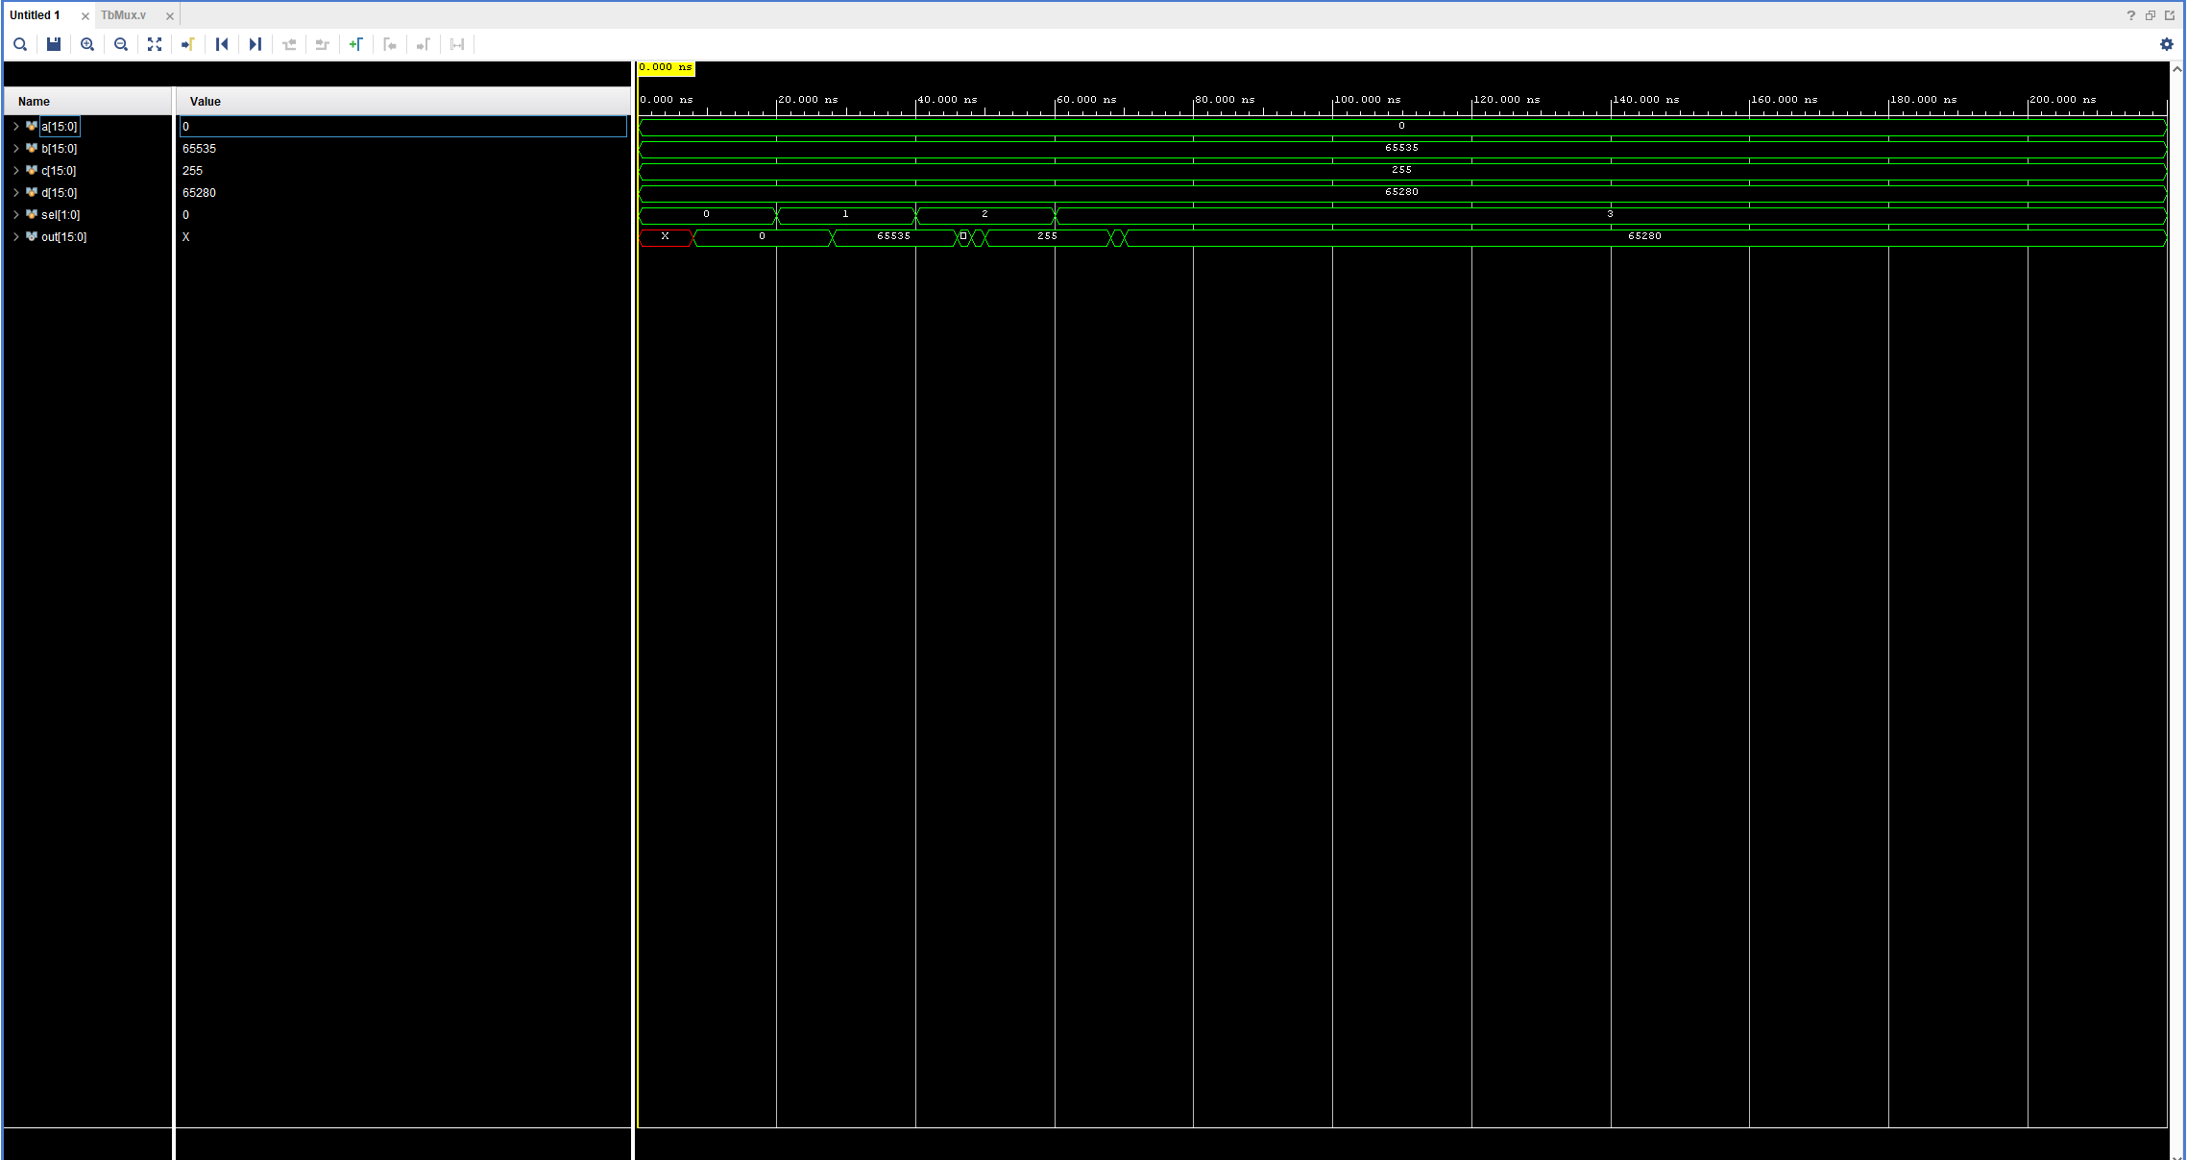
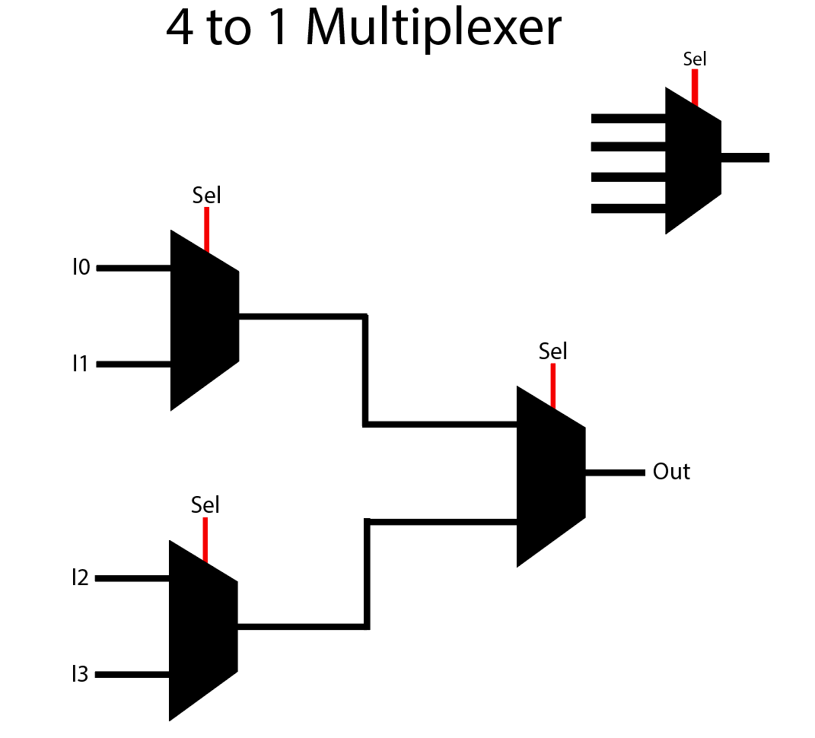
Circuit Specifics: Multiplexers
4-Bit Multiplexer Waveform

Slide 7
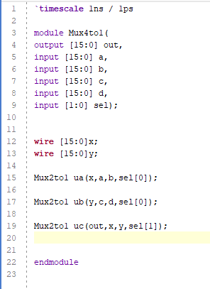
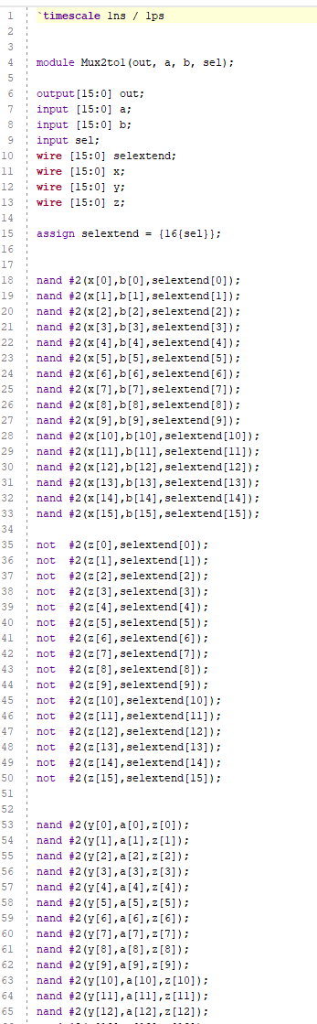
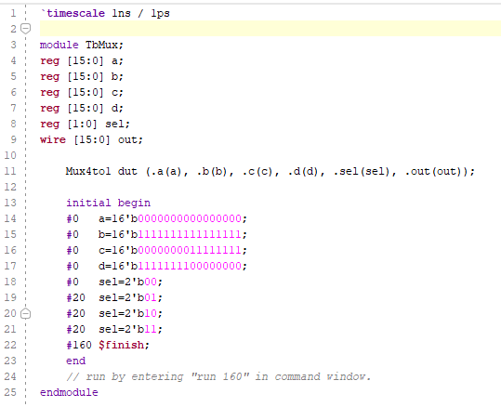
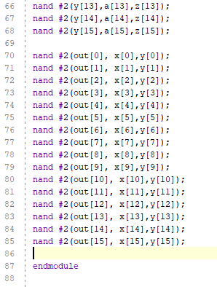
Circuit Specifics: Multiplexers
4to1 8-Bit Multiplexer
2to1 8-Bit Multiplexer
4to1 Mux Test Bench

Slide 8
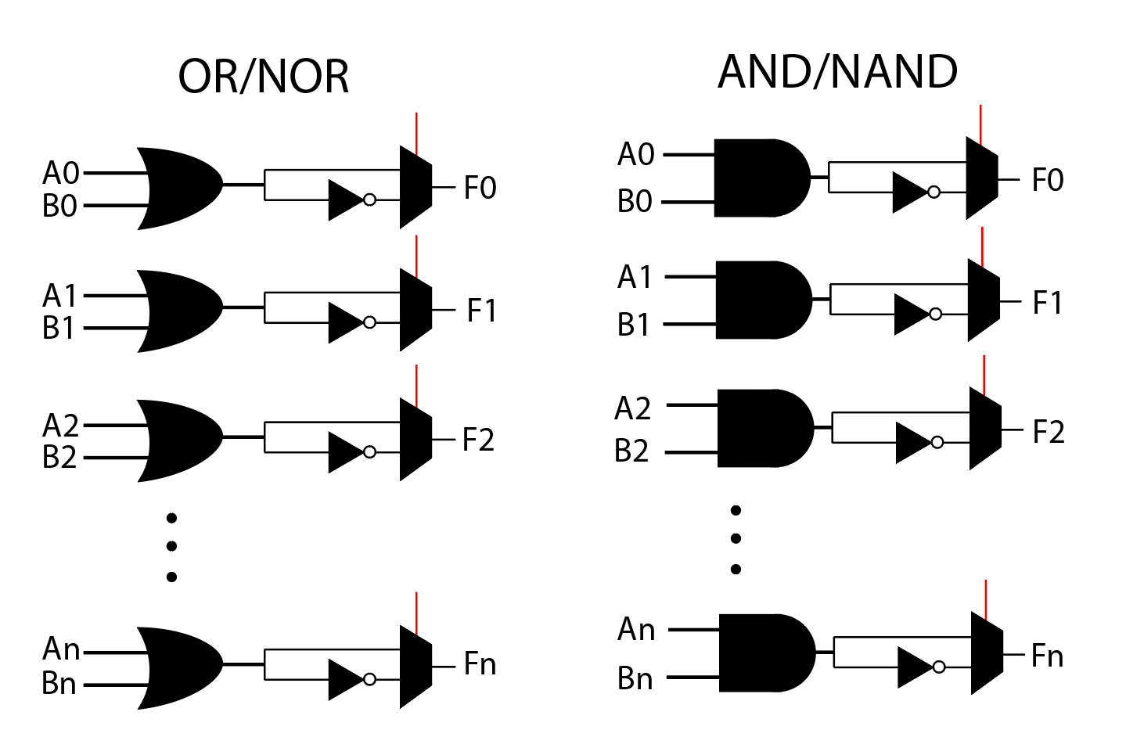
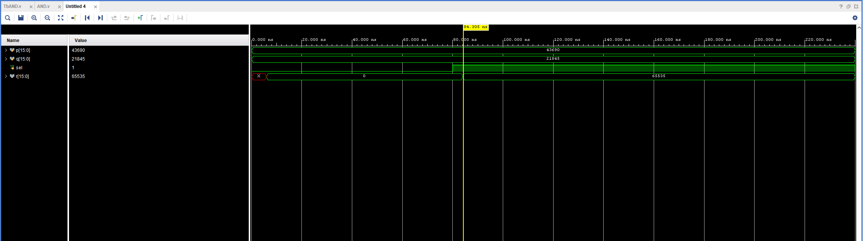
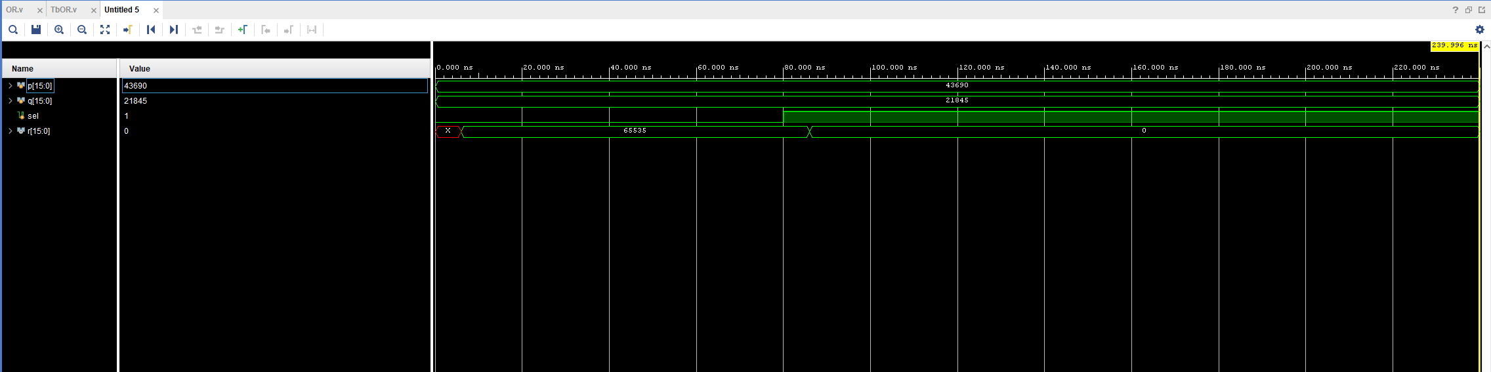
Circuit Specifics: AND/NAND + OR/NOR
AND/NAND Waveform
OR/NOR Waveform
Waveforms use Numbers
p = 1010 1010 1010 1010
q = 0101 0101 0101 0101

Slide 9
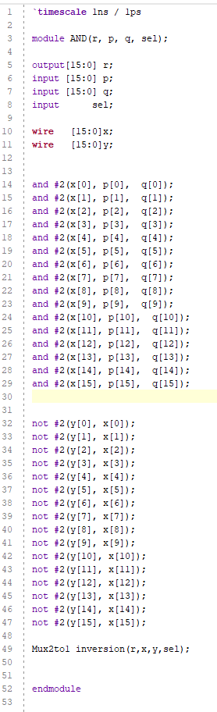
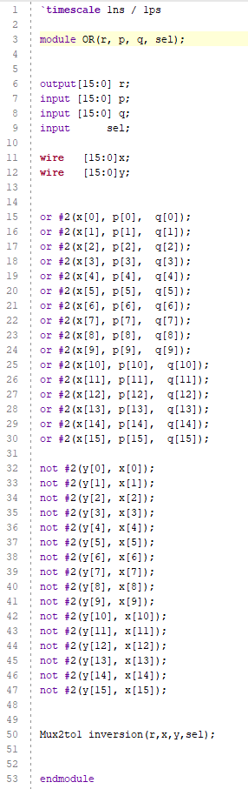
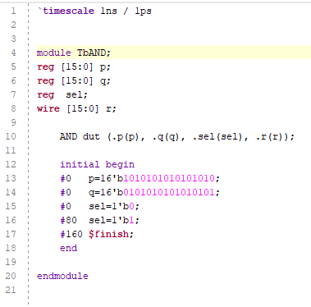
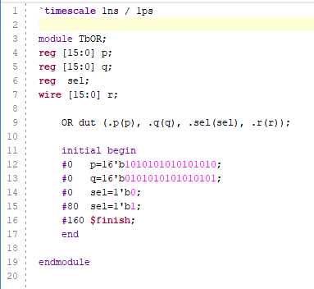
Circuit Specifics: AND/NAND + OR/NOR
AND/NAND
OR/NOR
AND/NAND Test Bench
OR/NOR Test Bench

Slide 10
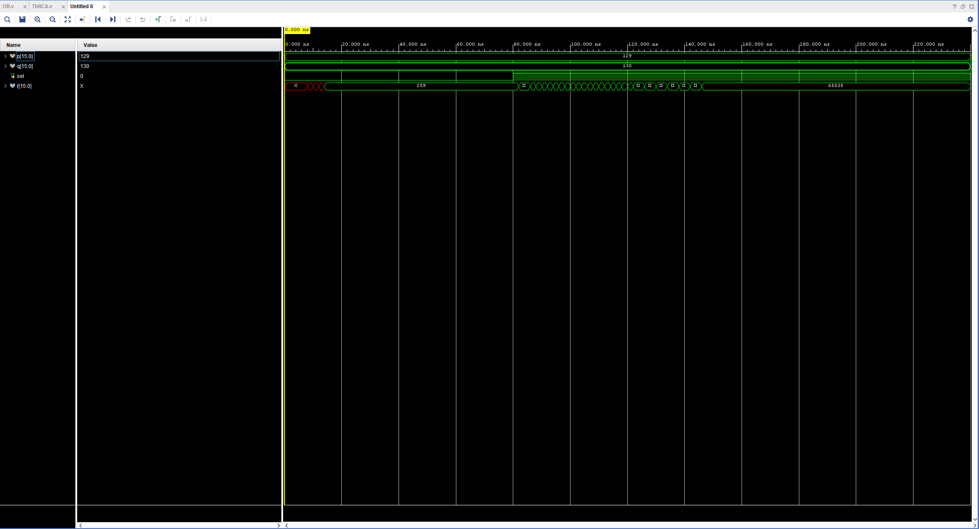
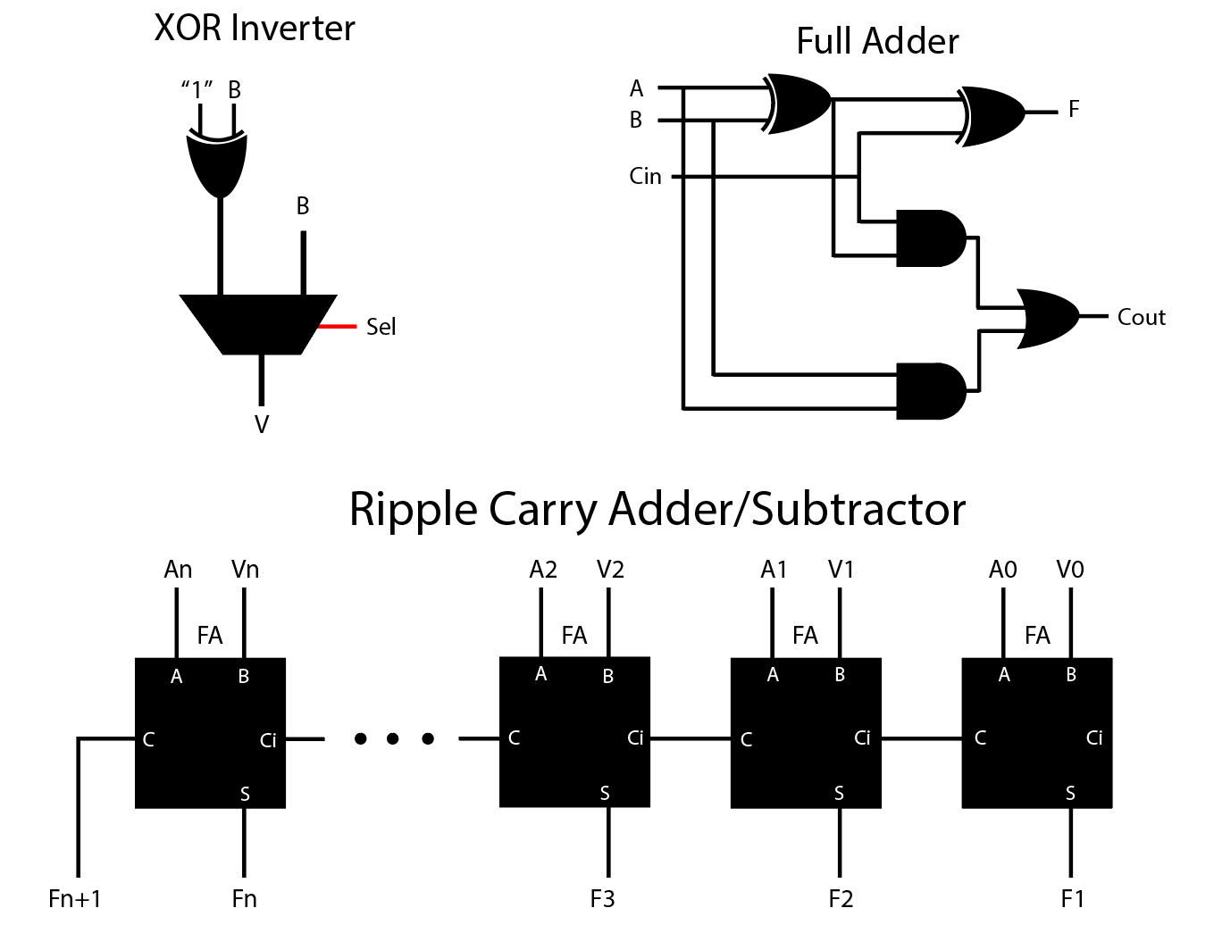
Circuit Specifics: Ripple Carry Adder/Subtractor
RCA Waveform

Slide 11
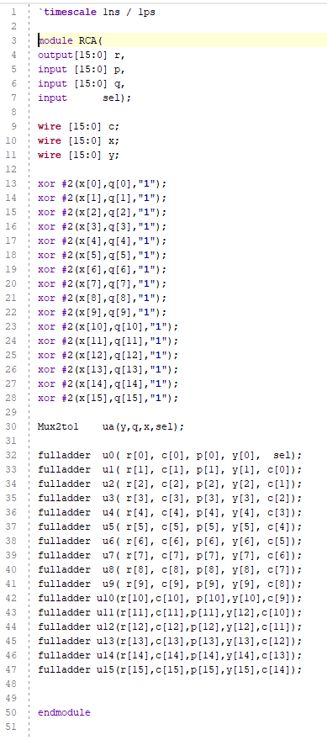
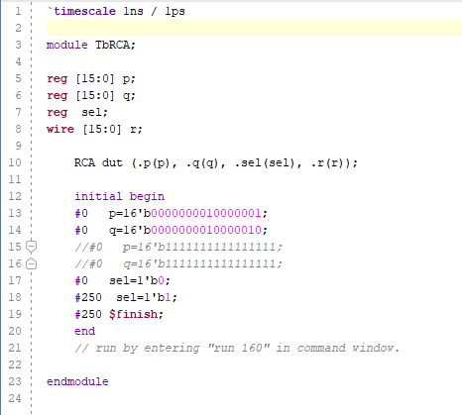
Circuit Specifics: Ripple Carry Adder/Subtractor
RCAS
RCA Test Bench

Slide 12
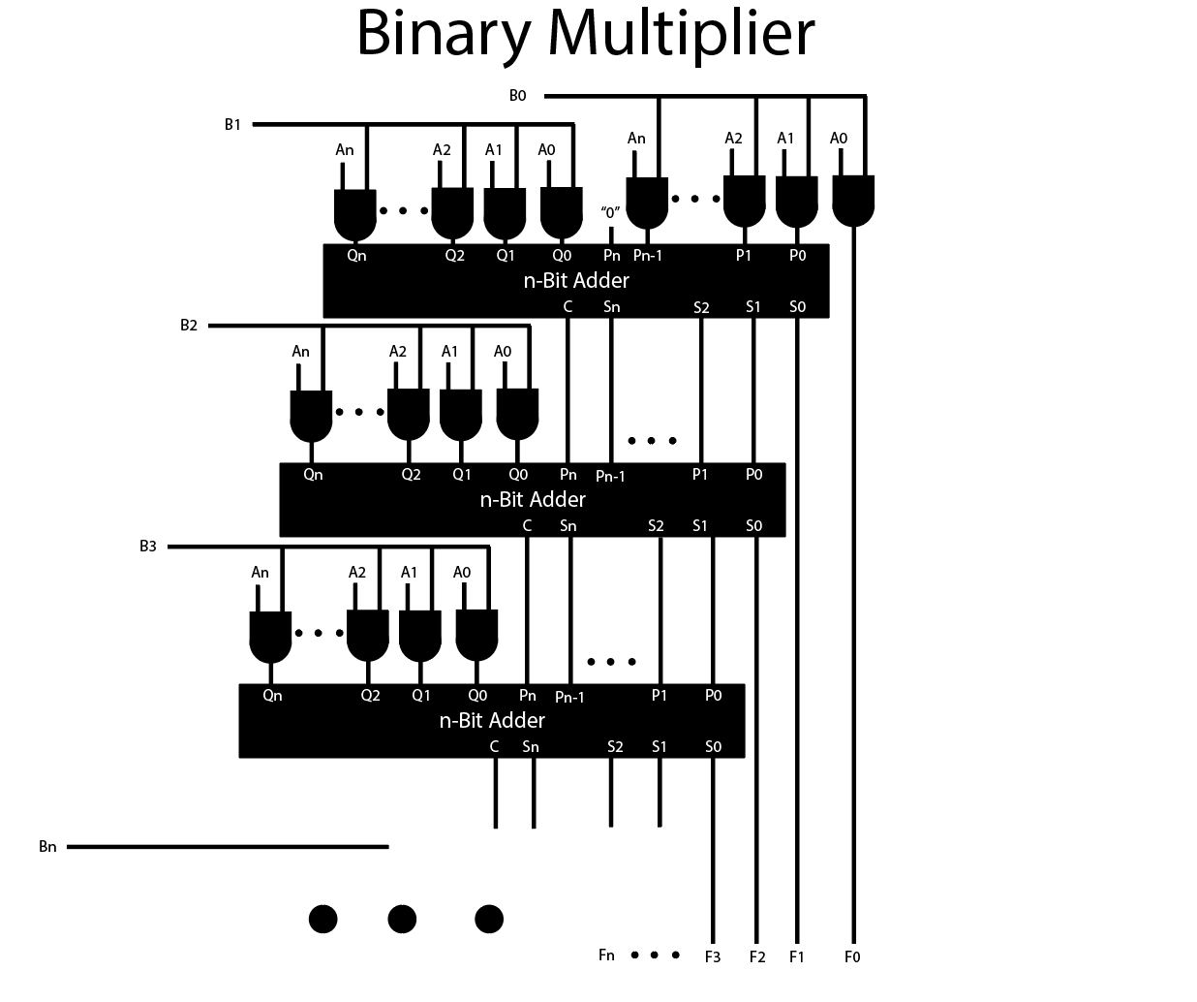
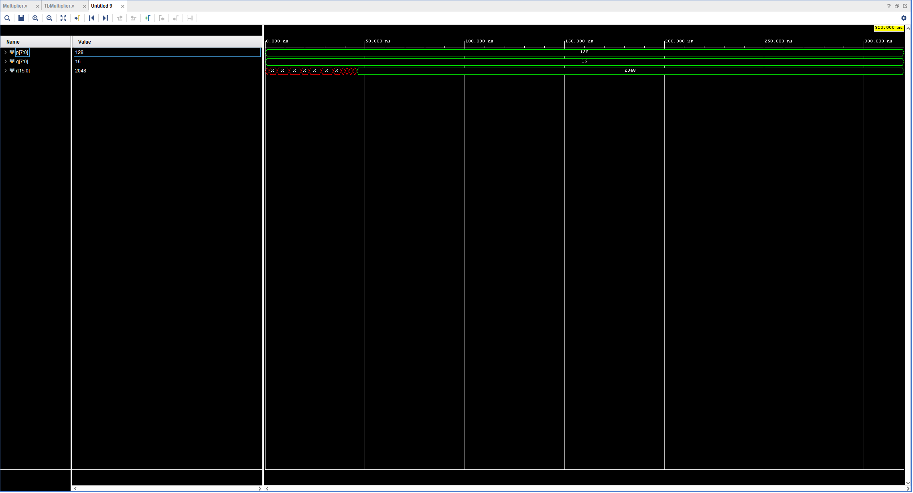
Circuit Specifics: 8x8 Multiplier
8x8 Multiplier Waveform

Slide 13
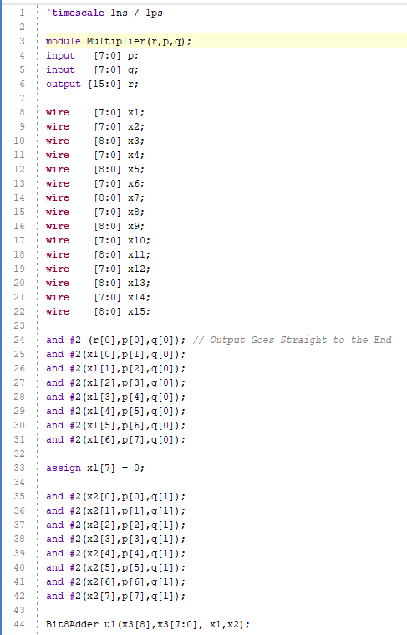
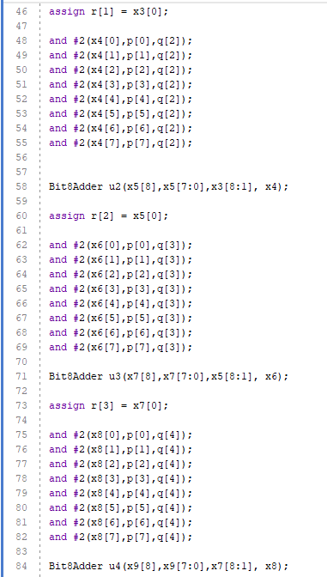
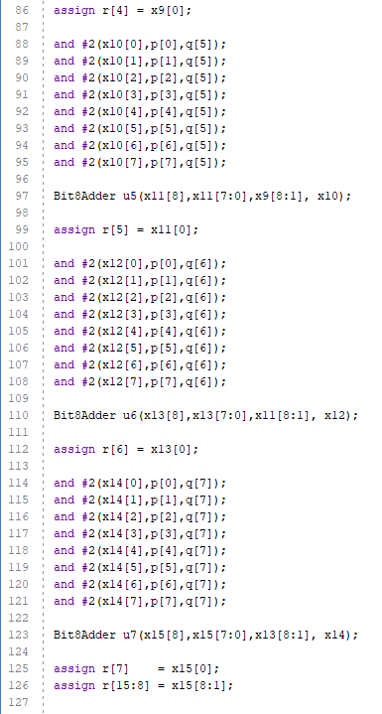
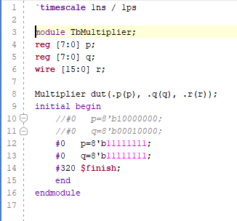
Circuit Specifics: 8x8 Multiplier
8x8 Multiplier
Multiplier Test Bench

Slide 14
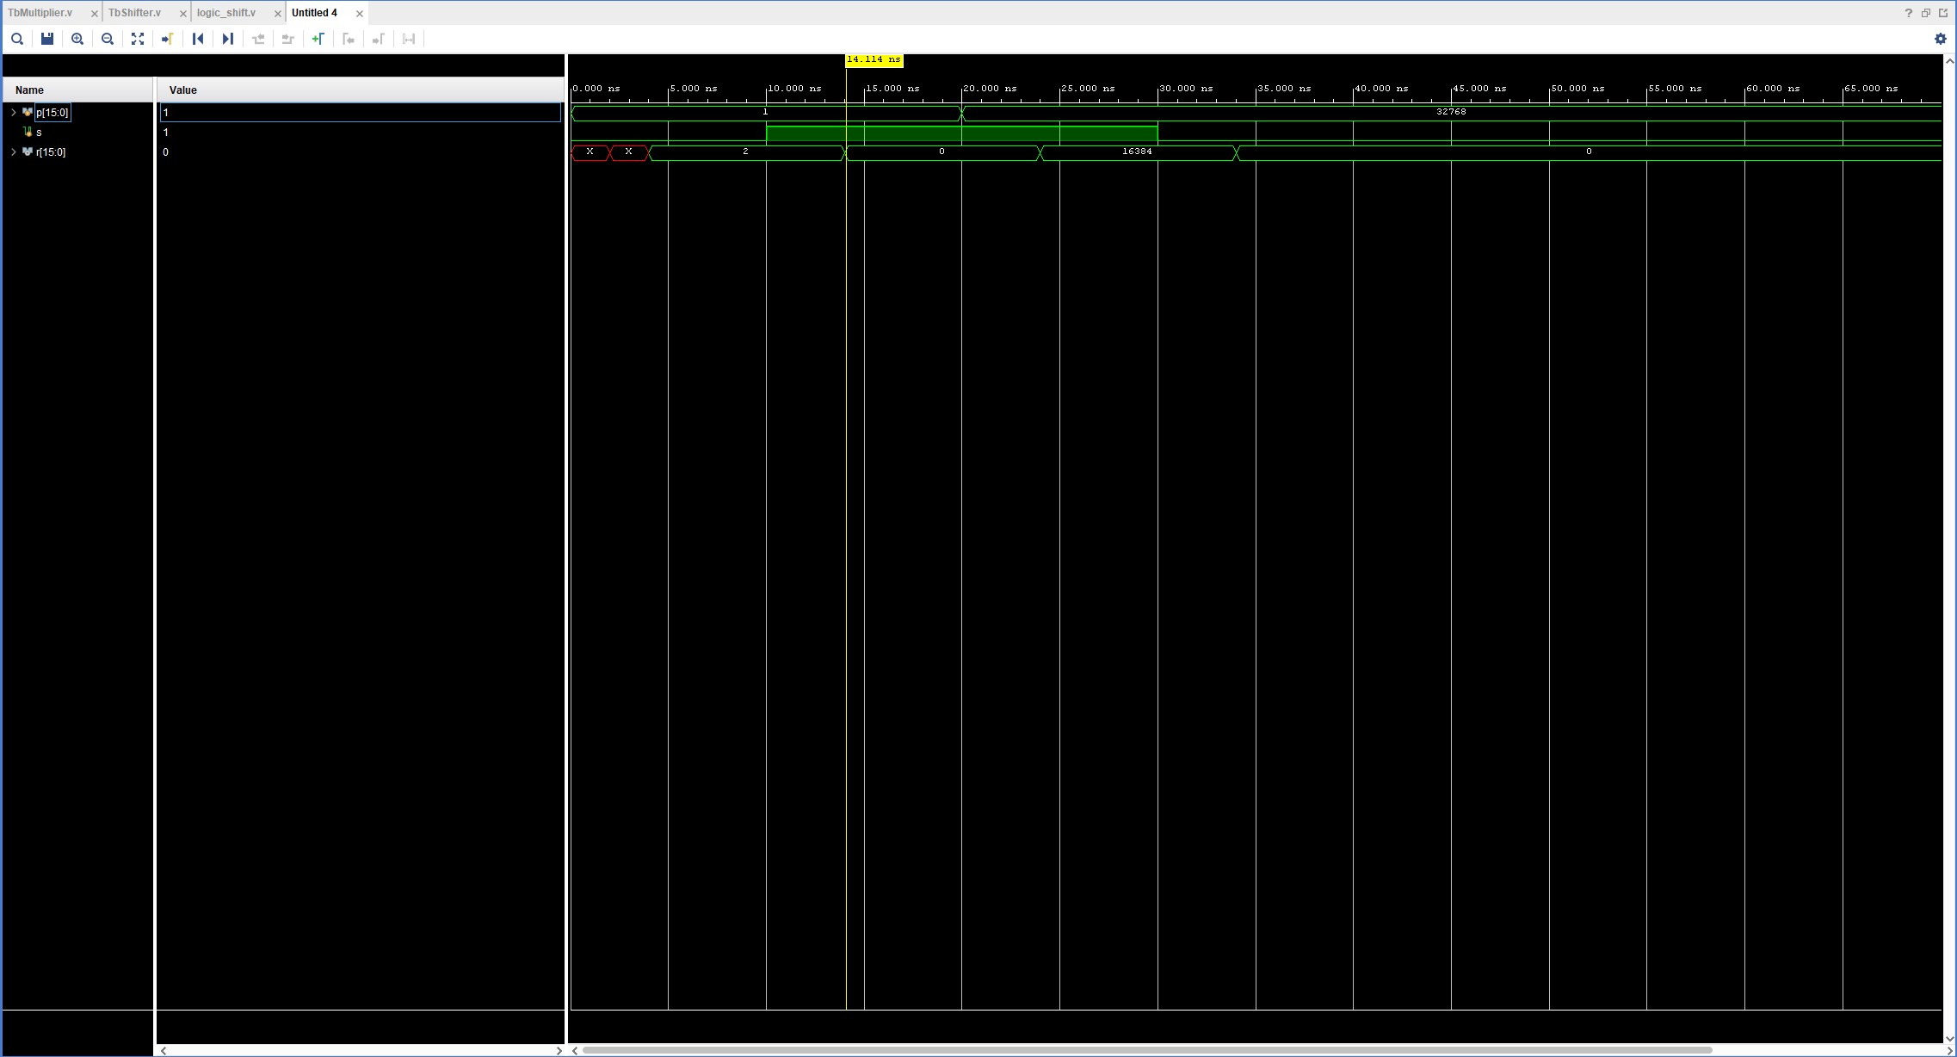
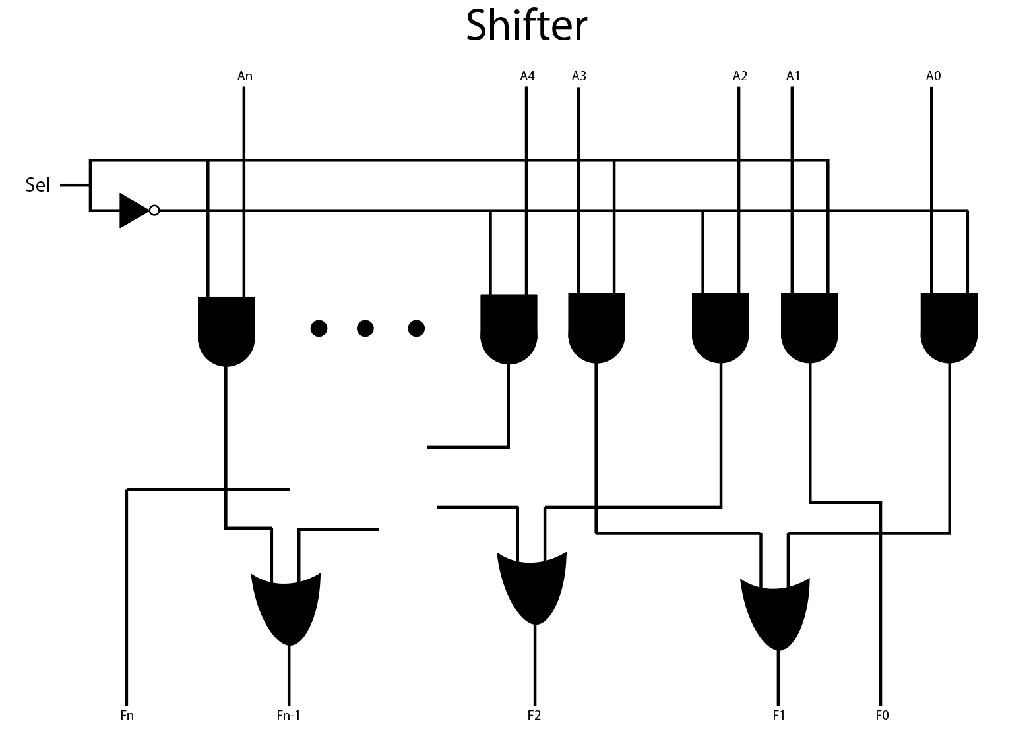
Circuit Specifics: Shifter

Slide 15
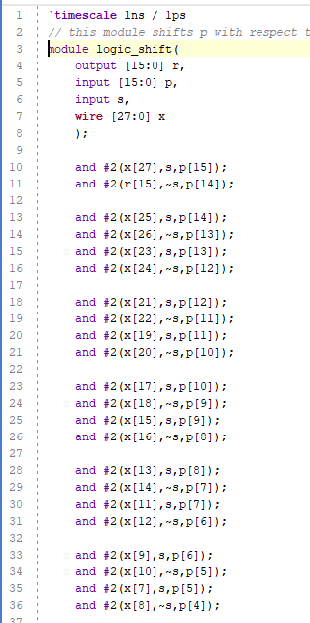
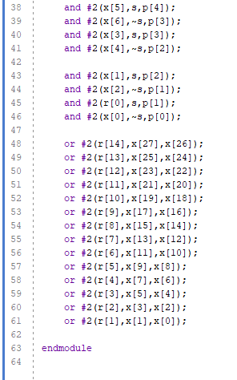
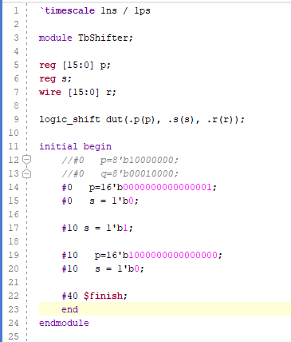
Circuit Specifics: Shifter
Shifter
Shifter Test Bench

Slide 16
Overall Schematic

Slide 17
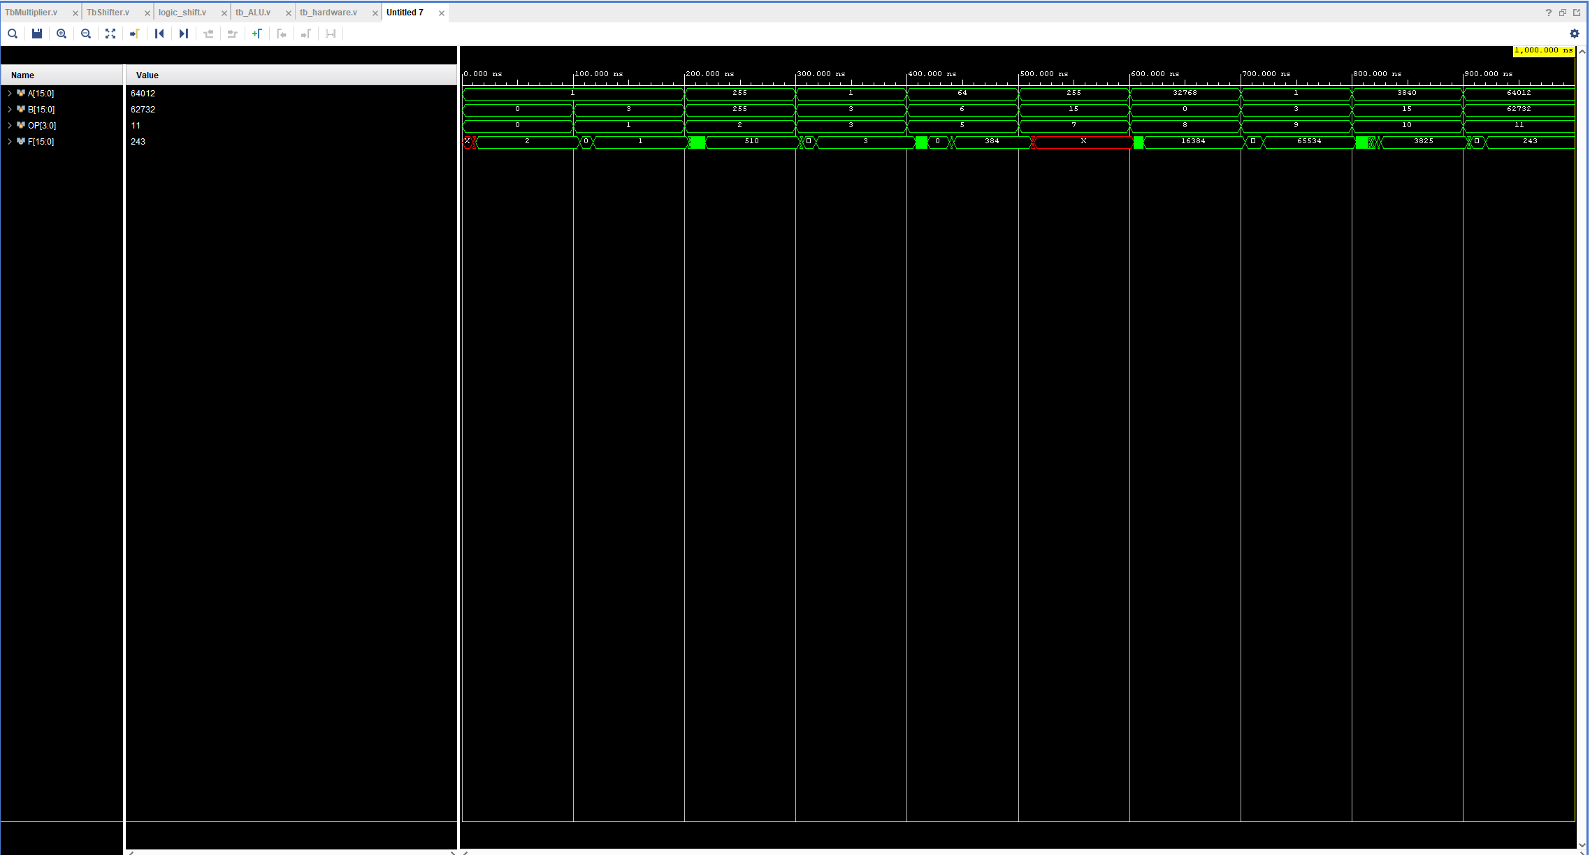
ALU Hardware Waveform
L-Shift
AND
Addition
OR
Multiply
No Op
R-Shift
NAND
Subtraction
NOR

Slide 18
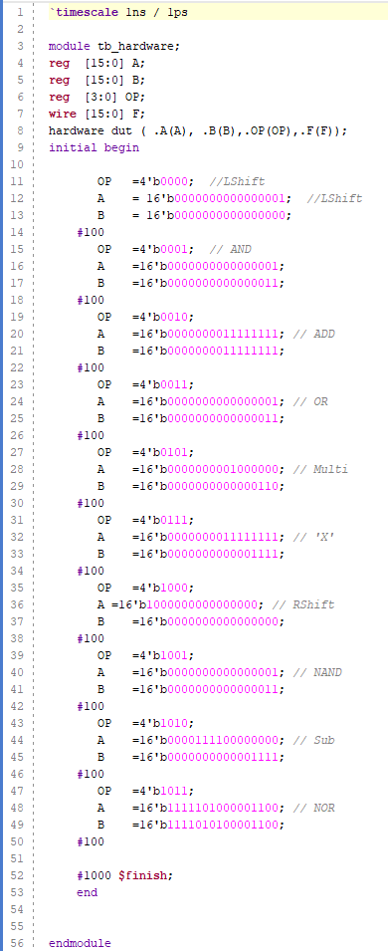
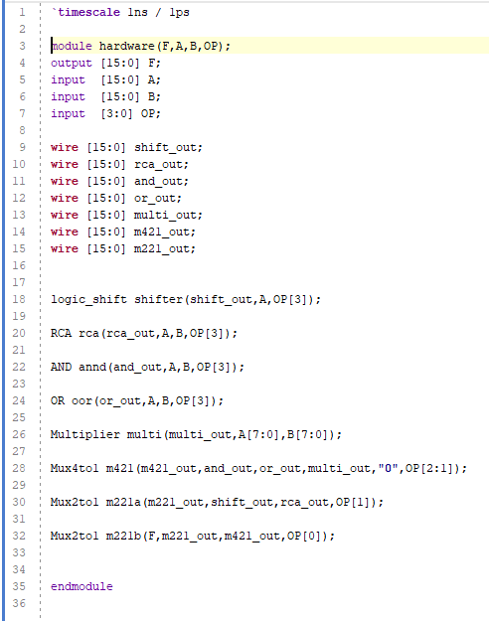
ALU Hardware Waveform
ALU Hardware Test Bench
ALU Hardware
L-Shift
AND
Addition
OR
Multiply
No Op
R-Shift
NAND
Subtraction
NOR

Slide 19
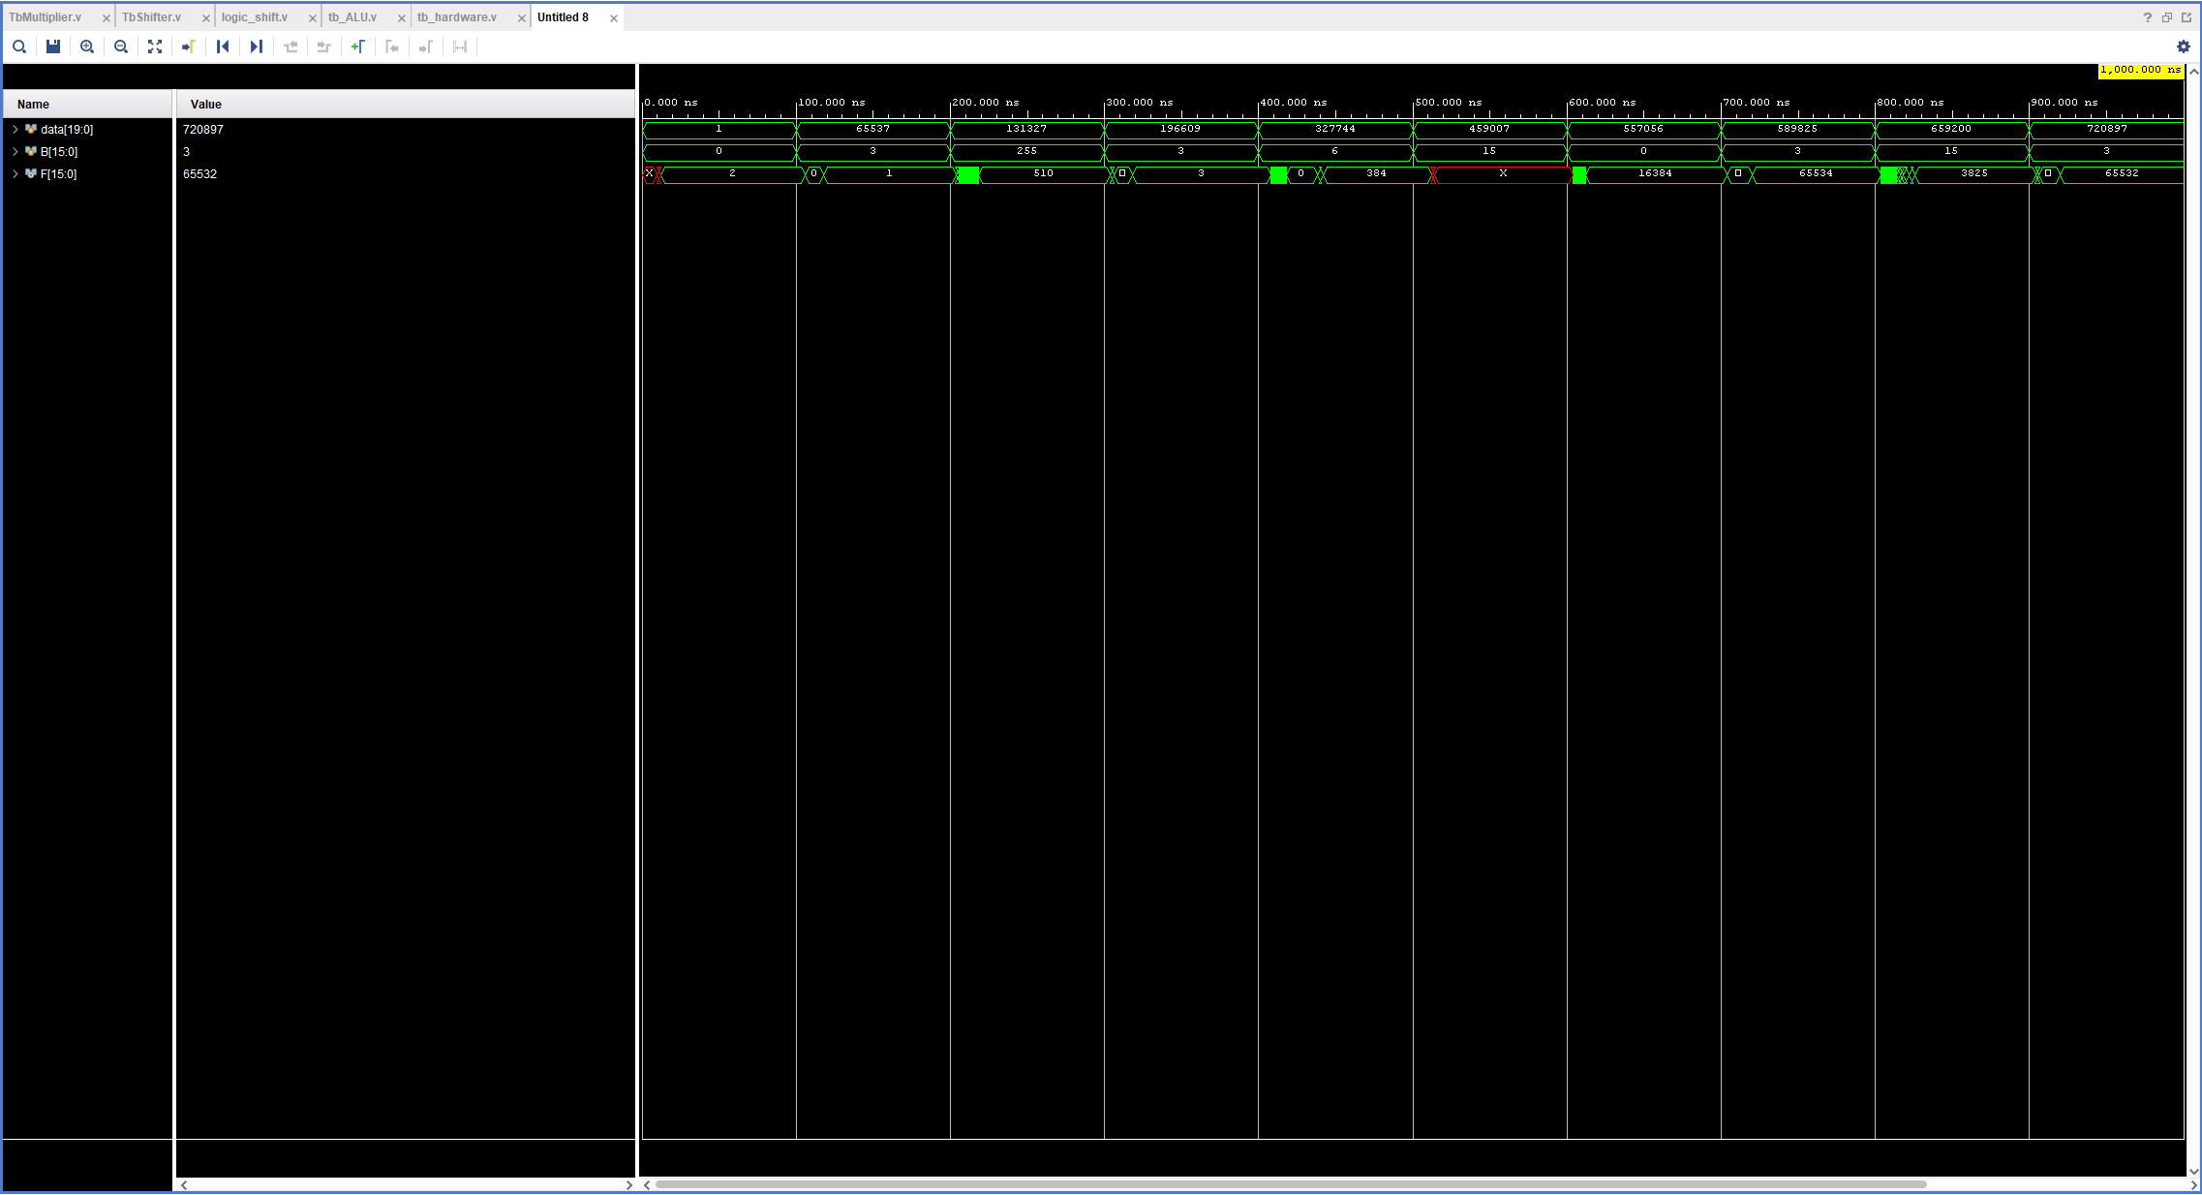
ALU w/ Control Unit Signals Waveform
L-Shift
AND
Addition
OR
Multiply
No Op
R-Shift
NAND
Subtraction
NOR

Slide 20
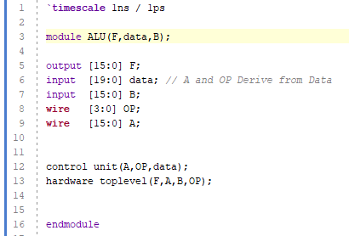
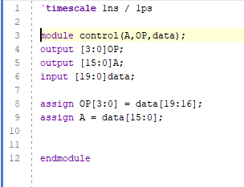
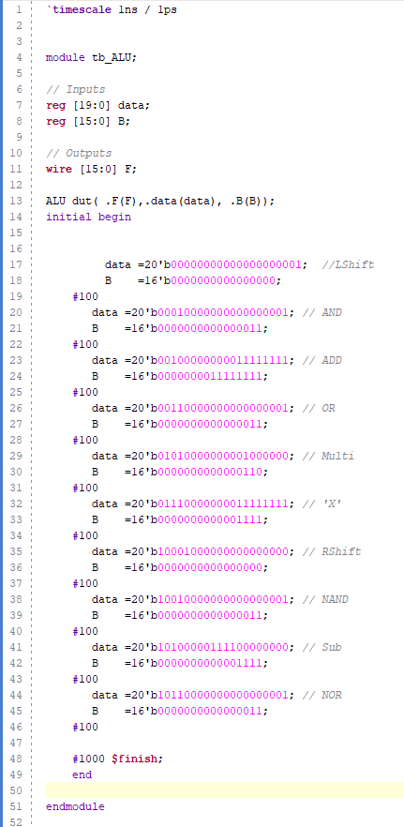
ALU w/ Control Unit Signals Waveform
ALU Test Bench
ALU
Control Unit
L-Shift
AND
OR
Multiply
No Op
R-Shift
NAND
Subtraction
NOR

